Slide 1
Image recognition in fashion
GA Data science Final project
Nigel seow

Slide 2
introduction
Decrease in brick and motar stores
Rise of ecommerce
Importance of technology
Notes:
- As ecommerce grows, so does the quantity of products available online.
Blogshops, which have less quantity, can afford to rely on human input to manually categorise their products.
However, stores with huge quantities of clothes are still largely depending on human input eg. Data entry companies to categorise their products.
It is a tiresome job and might be prone to human error.

Slide 3
The challenge
How to categorise clothes using image recognition
Benefits:
Capable of categorising within a shorter period of time
Can be used with image crawling
A well-trained model could provide better accuracy than human labour

Slide 4
Preparations Categories
Dresses
Tops
Bottoms
Skirts
One-pieces
Bodysuits

Slide 5
Preparations dataset
6 folders of the six clothes categories
200+ images per folder
Each piece of clothing is arranged in a “flatlay” format with a plain background.
Fair distribution of different types of clothes per category.

Slide 6
Implementation
Conversion from jpg to bmp Code link
Conversion to grayscale and downsizing of images Code link
Notes:
BMP images are smaller in size and will take a shorter time to run.
Purpose of grayscale: 1 channel is used rather than 3 channels for RGB. Results are more accurate when colour is omitted and focus is on shape.

Slide 7

IMPLEMENTATION
GoogLeNet
Benefits:
Deeper and Wider
Batch Normalization
Factorization
Redual Connection
Notes:
1) Deeper and Wider: Larger datasets can be fit better than others. The information that each layer learns is so rich that information in high level layer is more abstract and discriminate, and this is very important for image classification. For smaller datasets, we can fine tune the pretrain-model that others have trained to fit our datasets.
2) Batch Normalization: This is a very powerful trick for training networks. It can decrease internal covariate shift, and also gradient vanish. This can make the transformation from data to label more stable.
3) Factorization: Factorization makes the number of parameters less and speeds up the training process, also avoids overfits.
4) Redual Connection: We can train a 100+ layers depth networks(also 1000+ layers) in a easy way. Deeper networks are good for feature extraction.

Slide 8
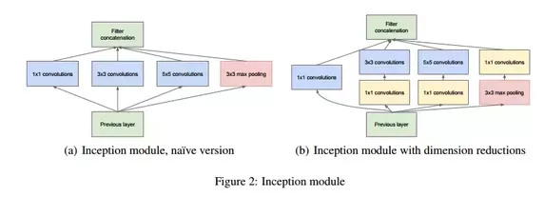
IMPLEMENTATION
GoogLeNet Explained
Many tiny convolutional kernels in this networks, such as 1x1, 3x3, 5x5 whose ideas comes from VGG-series-networks, just like following picture, named Inception module:

Slide 9
IMPLEMENTATION
GoogLeNet Explained
- The tiny kernels can catch the detail information in the image. Also, they can avoid information leaked.
These tiny kernels can compose a network with less parameters than larger kernels. This can avoid overfitting when we train the networks. When the network goes deep, layers which are in high level can get a big vision in the image that is the core of CNN. We can find the 1x1 kernel in the right picture from the previous slide, it is used to reduce dimensions of channels.
In the Inception module, these tiny kernels are concanated to be the inputs of the next Inception module, which is equal to integrate all information about the part of the image, the information can be texture, color, size, location .etc,
It makes the network wider in this way, where the network can “see” a larger vision in image, we can find the information the networks learned.

Slide 10
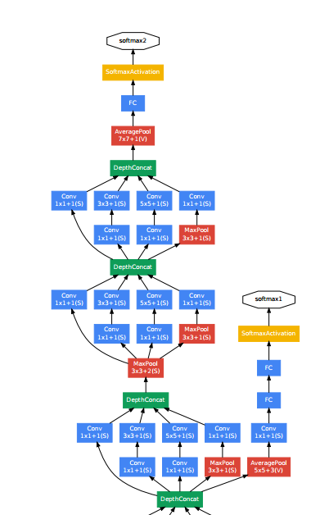
IMPLEMENTATION
GoogLeNet Explained
- The picture shows a part of GoogLeNet, also GoogLeNet is made of this module. We can find softmax in every part of GoogLeNet, it is used to control parameters when we train the networks in case of the gradient vanishing. So with the ImageNet Datasets that is so larger, so this deeply networks can get a pretty good performance.
Convolution
Pooling
Softmax
Other

Slide 11
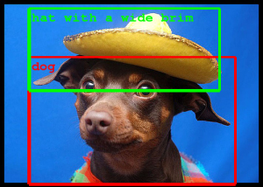
Implementation Model
Image detection/mapping
Either this or that
Notes:
Googlenet will map out the image and detection will be done based on shapes.
“Either Or” concept. Model will have to select the categories based on those supplied.

Slide 12
Implementation Model (Black/white images)
Reading the data using PIL and training the model. 80% training, 20% test. Github Link
Implementation of model Github Link
Results: About 94% Github Link
Notes:
1 channel used for Black/White images.

Slide 13
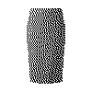
Implementation Results (Black/White images) Top 10
Accuracy rate: 0.999818742275238
SKIRT

Slide 14
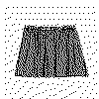
Implementation Results (Black/White images) Top 10
Accuracy rate: 0.9998509883880615
SKIRT

Slide 15
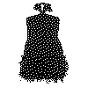
Implementation Results (Black/White images) Top 10
Accuracy rate: 0.9882128834724426
DRESS

Slide 16
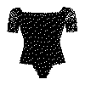
Implementation Results (Black/White images) Top 10
Accuracy rate: 0.9999974966049194
BODYSUIT

Slide 17
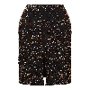
Implementation Results (Black/White images) Top 10
Accuracy rate: 0.999818742275238
SKIRT

Slide 18
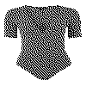
Implementation Results (Black/White images) Top 10
Accuracy rate: 0.9999759197235107
BODYSUIT

Slide 19
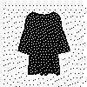
Implementation Results (Black/White images) Top 10
Accuracy rate: 0.9998455047607422
ONE-PIECE

Slide 20
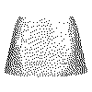
Implementation Results (Black/White images) Top 10
Accuracy rate: 0.9994718432426453
SKIRT

Slide 21
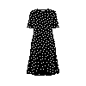
Implementation Results (Black/White images) Top 10
Accuracy rate: 0.9976770281791687
DRESS

Slide 22
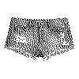
Implementation Results (Black/White images) Top 10
Accuracy rate: 0.9995296001434326
BOTTOM

Slide 23
Implementation Model
The next step will be to test the model with Colour Images
3 channels (RGB) used

Slide 24
Implementation Model (Colour images)
Reading the data using PIL and training the model. 80% training, 20% test. Github Link
Implementation of model Github Link
Results: About 86% Github Link

Slide 25
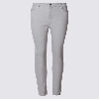
Implementation Results (Colour images) Top 10
Accuracy rate: 0.999900221824646
BOTTOM

Slide 26
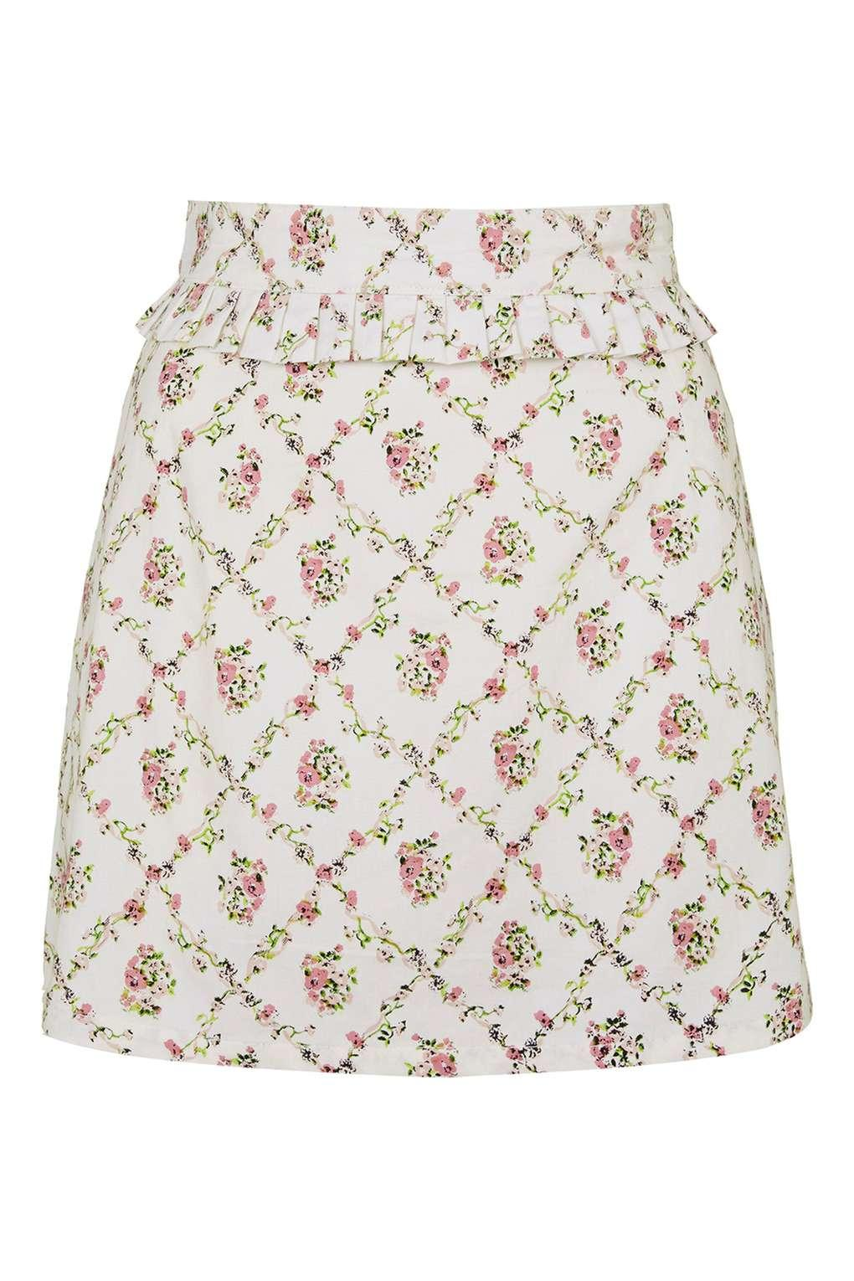
Implementation Results (Colour images) Top 10
Accuracy rate: 0.6777806878089905
SKIRT

Slide 27
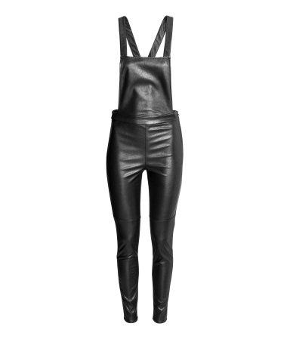
Implementation Results (Colour images) Top 10
Accuracy rate: 0.9991852641105652
ONE-PIECE

Slide 28
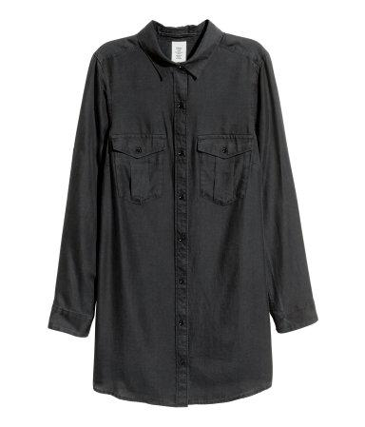
Implementation Results (Colour images) Top 10
Accuracy rate: 0.8781151175498962
TOP

Slide 29
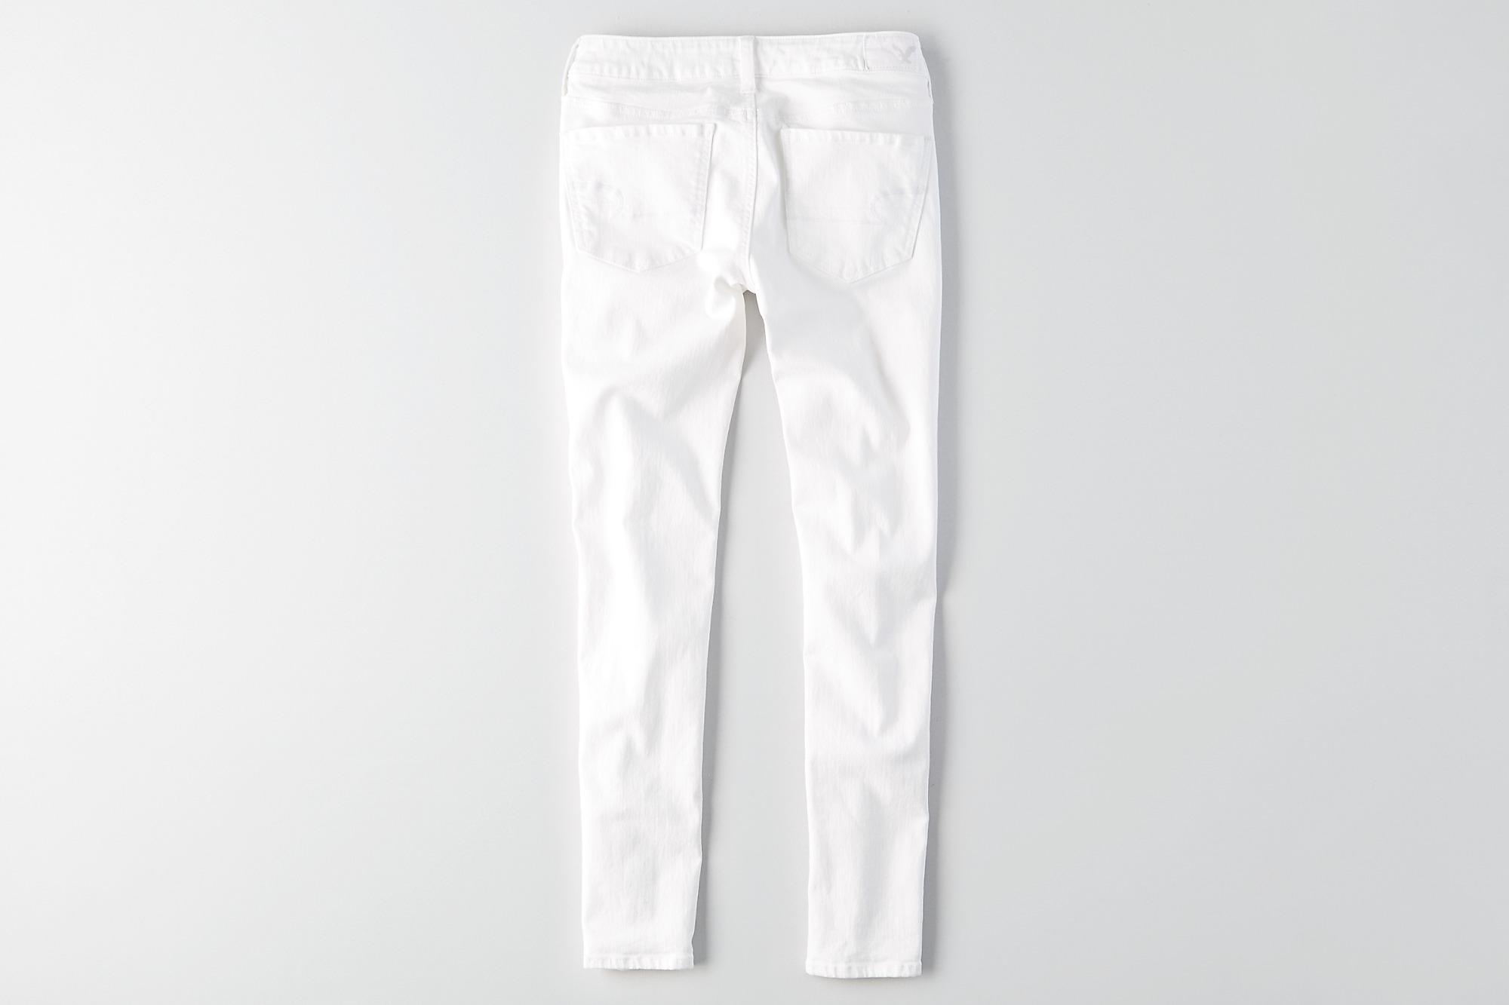
Implementation Results (Colour images) Top 10
Accuracy rate: 0.9963659048080444
BOTTOM

Slide 30
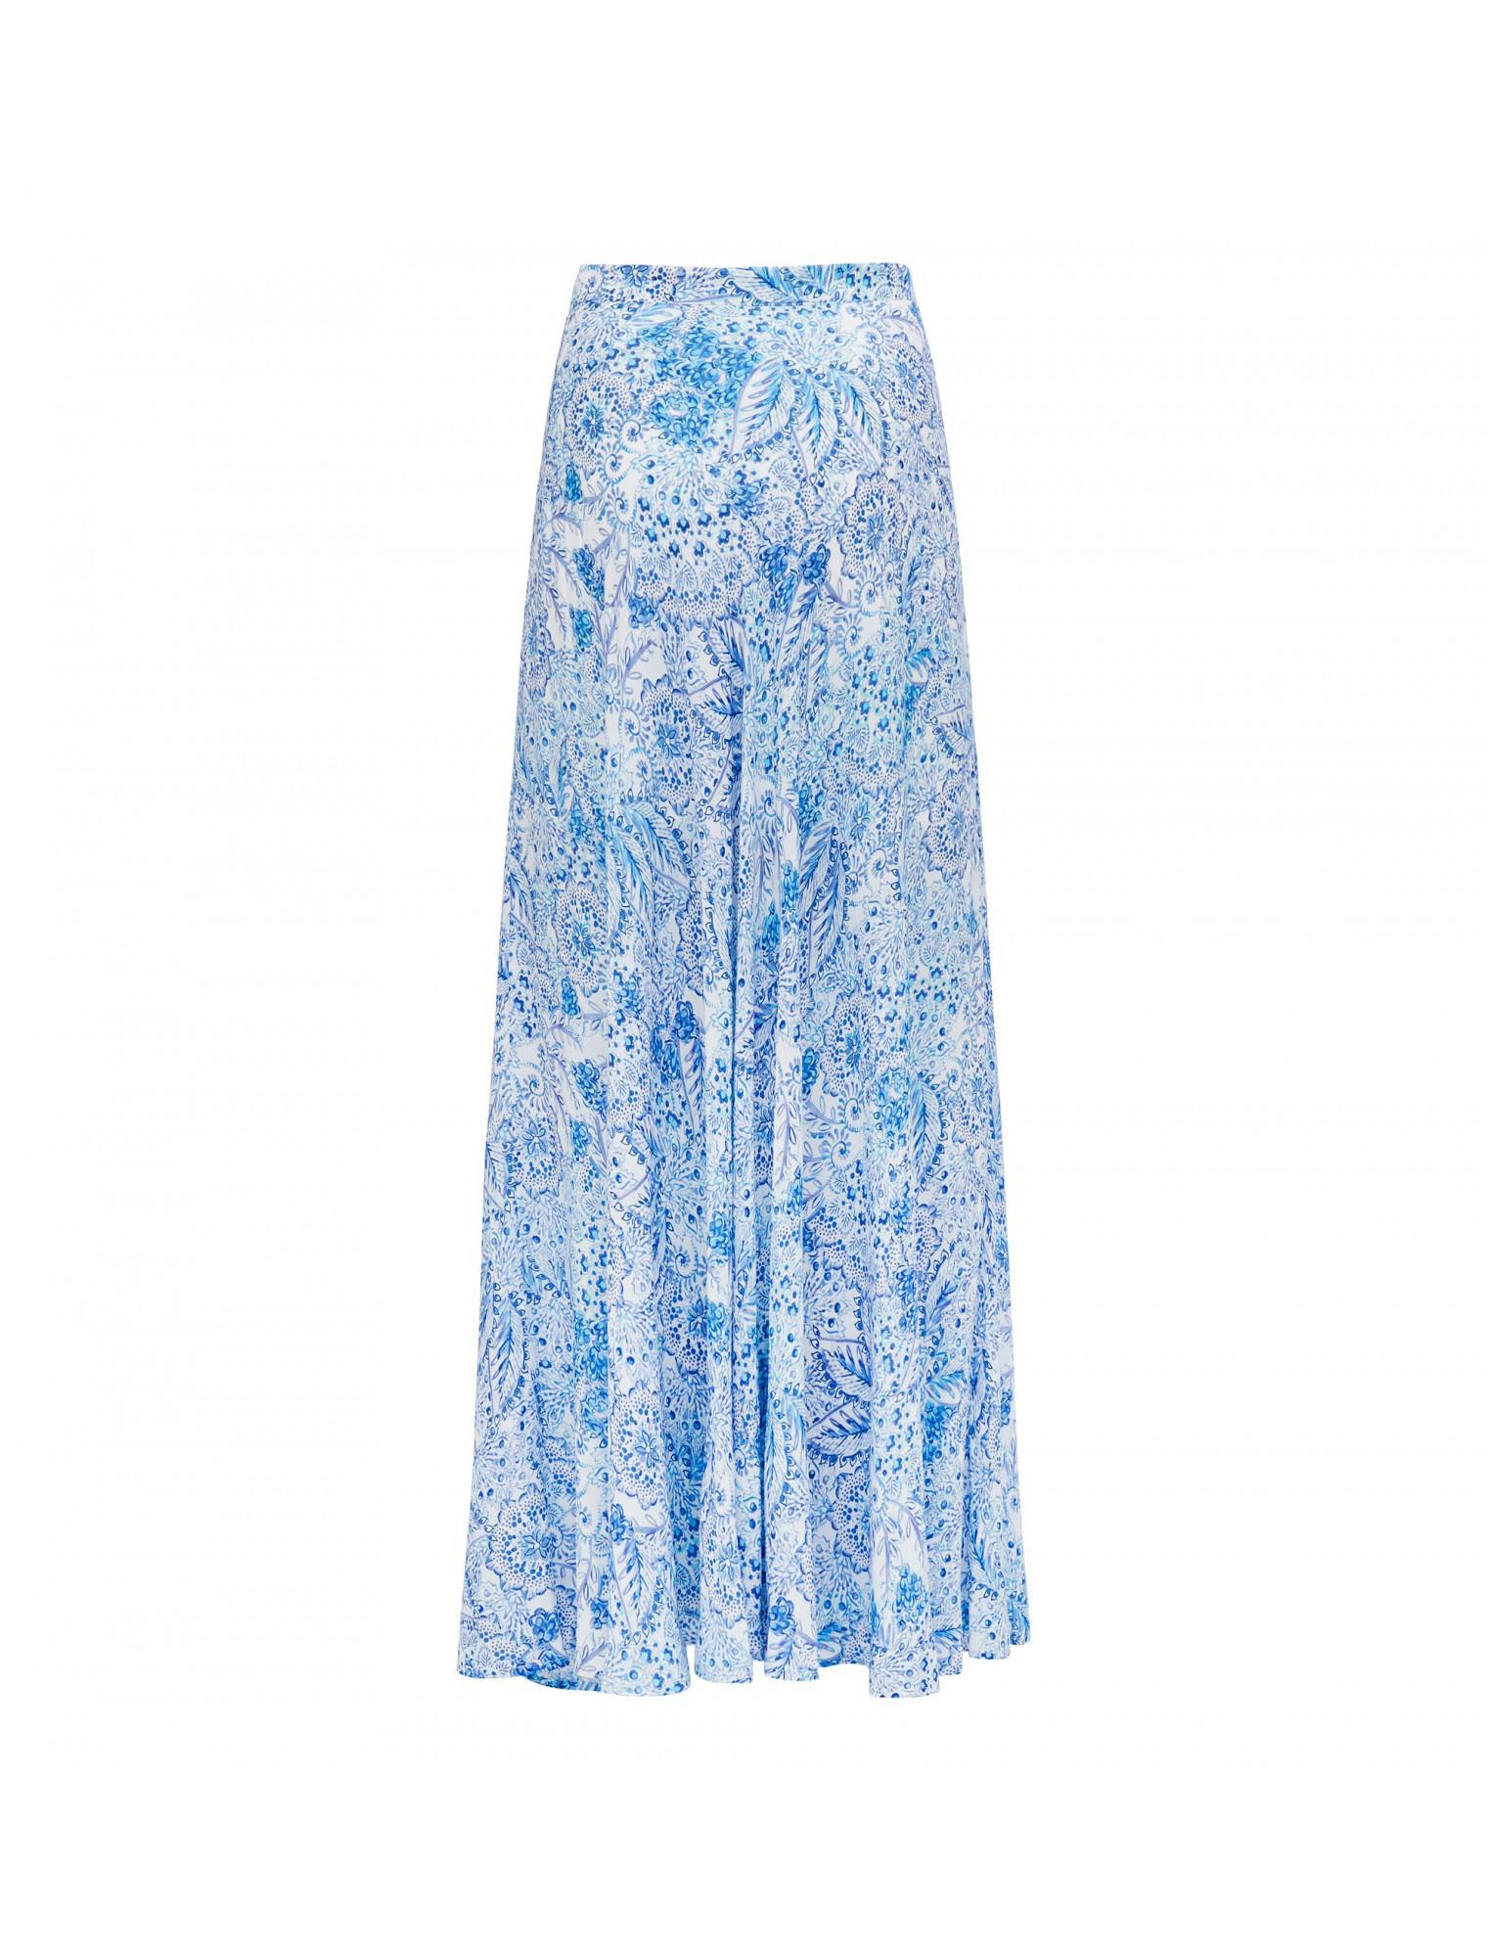
Implementation Results (Colour images) Top 10
Accuracy rate: 0.8170945644378662
SKIRT

Slide 31
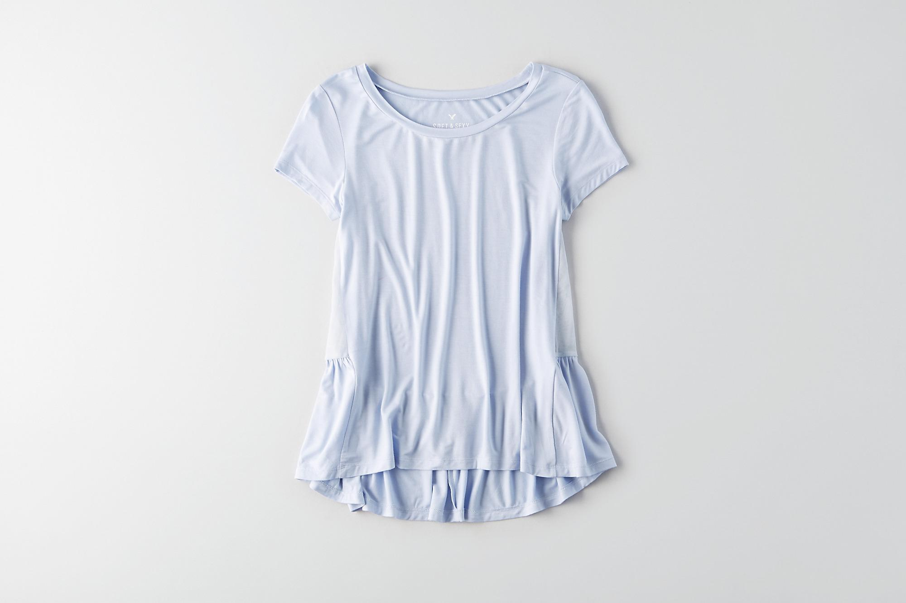
Implementation Results (Colour images) Top 10
Accuracy rate: 0.9998843669891357
TOP

Slide 32
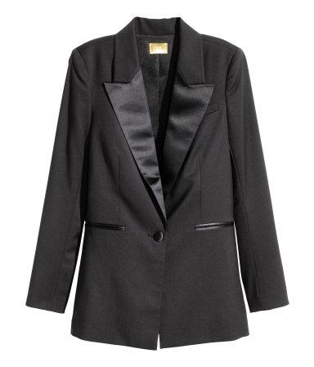
Implementation Results (Colour images) Top 10
Accuracy rate: 0.9993380904197693
OUTERWEAR

Slide 33
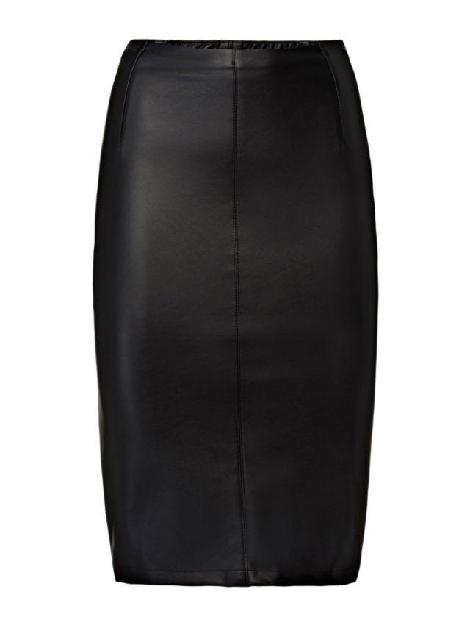
Implementation Results (Colour images) Top 10
Accuracy rate: 0.8633781671524048
SKIRT

Slide 34
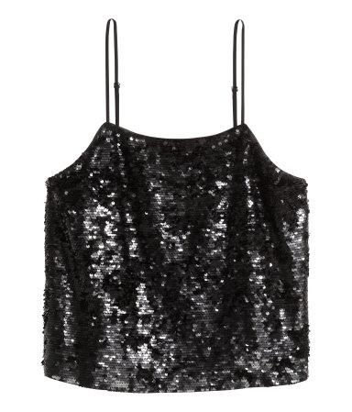
Implementation Results (Colour images) Top 10
Accuracy rate: 0.8403425812721252
TOP

Slide 35
Implementation Limitations
Not all fashion ecommerce websites have product images with plain backgrounds.
Can only detect main categories, but not sub-categories

Slide 36
Taking it further
Train model to detect clothes on human models
Incorporate detection for sub-categories eg. Bodycon dress, A-line skirt, etc.

